Slide 1
Database Design Fundamentals
Louis Davidson
nerd

Slide 2


Slide 3
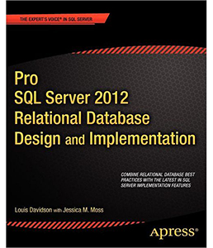
Who am I?
Been in IT for 20-some years
Microsoft MVP For 12 Years
Corporate Data Architect
Written 5.903 books on
database design
  They were technically all versions
  of the same book. They at least
  had slightly different titles each time
  New book later this year with some new stuff
Super Brief Contact Info: DRSQL
  Twitter, Website (.org), Email (@hotmail.com)
Notes:
Change it to planning the next version

Slide 4
Pre-Design Tasks
Think: What problem are we really trying to solve? Communicate: Get agreement from all involved that you are solving the right problem
  Users
  Management
    Project
    Client
  Programmers
  Anyone else who might disagree with you and cause your design harm later. (other than your significant other, unless you work together.)
The common term for what you need is Requirements

Slide 5

Requirements are like Family Vacation Plans
If everyone decided on Lake Eerie (instead of Erie), then everyone is to blame

Slide 6
WRITE REQUIREMENTS DOWN
WRITE IT DOWN. Seriously.
True for Agile, Extreme, or Full Blown Committee Driven Waterfall
Use to provide the target for the rest of the project
  Design
  Coding
  Testing
Make certain you get sign-off from all decision makers
Anything not written down can and will change without notice
WRITE IT DOWN. Before you code. I mean it.

Slide 7

Design goal
A database that works well, and meets your needs, and doesn’t lie to you more than you expect it to…
…and (if so determined to be something that needs the guarantees of the relational engine) within the constructs of the relational engine

Slide 8
Prerequisites
There are no variations except for those who know a norm, and no subtleties for those who have not grasped the obvious.
  C. S. Lewis, An Experiment in Criticism

Slide 9
Prerequisites.Relational History/Theory
Codd’s Rules
  13 Rules that qualified a system as a “relational” database system, written back in 1985 (I was in high school)
  Will help you see the thought process behind how products like SQL Server are implemented
  Outlines aspects of RDBMs, including: Catalog; Data Access (and a lack of direct physical access); NULLs; Integrity controls; Set based operations
Basic relational theory
  Trade books
  Textbooks
  College classes

Slide 10
Database Design Process
Conceptual
  Early model, generally representing the tables or things being modeled and their relationship to each other
Logical
  Ideal representation of the problem that is trying to be solved. Generally the “complete” data requirements
Physical
  Represents what is actually implemented
Hardware Interface
  The on-disk structures (indexes, partitions, distribution, etc) that ideally have no bearing on anything other than performance
Physical is largely developer based, hardware interface is largely DBA focused…
These layers correspond loosely to deliverables called data models
Notes:
Remove layer from bullet

Slide 11


What does it mean to data model?
First of all, it will cost you more for dinner…
Secondly, this is way off the point

Slide 12
What does it mean to data model?
Design and capture the semantic details of the database
Including
  Structure
  Predicates
  Documentation
May include more than can be implemented
Most modeling languages have a graphical representation that makes communication easier
A picture is worth a thousand words when communicating with non-modelers
Notes:
May include more than can be implemented

Slide 13
Start with the Conceptual Model
Start by understanding the requirements
Build a Conceptual Model
  Tables (Nouns)
  Relationships (Connective sentences/phrases)
Validate (Test) the model against the requirements
  If YES (they do) Move On To Logical Model
  If NO, Keep Trying
Notes:
Title Get started with the..

Slide 14
Continue to the Logical Model
Create a Logical Model
  Columns (With legal values-domain)
  Uniqueness conditions (Keys)
  System Predicates
  Important: Understand what is good data, and what is NOT good data.
  It doesn’t matter how any of this can be implemented with or without SQL
Continue to test your design against the requirements
  If YES (they do), start moving towards building tables (Woo hoo!)
  If NO, keep refining the model
Notes:
Title Get started with the..

Slide 15
Tip – Start Out Naming Consistently
There are lots of naming standards out there.
Most importantly, name consistently
  Names should be as specific as possible
  Data should rarely be represented in the name
  Don’t use the English language as a guide (I before E except after C, unless?)
Early in the process, avoid abbreviations unless it is very apparent to everyone
  When you build the physical model, if you must abbreviate, use a data dictionary to make sure abbreviations are always the same
Tables
  Never prefixed to says that this is a table (tbl_TableName)
  Singular or Plural (either one)
    I prefer singular

Slide 16
Column Naming
Column names should be singular - Columns should (at least eventually) represent a scalar value
Avoid overly specific prefixes/suffixes
Follow a standard format for names
An example that I have seen documented in various places (often attributed to ISO 11179) is to have names that include something along the following:
  RoleName – Optional for when you need to explain the purpose of the attribute
  Attribute – The primary purpose of the column being named. Optionally can be omitted, meaning it refers to the entity
  Classword – a suffix that identifies the usage of the column, in non-implementation specific terms
  Scale – Optional to tell the user what the scale of the data is, like minutes, seconds, dollars, euros, etc
  RoleName_Attribute_Classword_Scale

Slide 17
Column Naming Examples
Name - a textual string that names the row value, but whether or not it is a varchar(30) or nvarchar(128) is immaterial (prefix is implied. Example Company.Name)
UserName - a more specific use of the name classword that indicates it isn’t a generic usage
AdminstratorUserName – A user name, but specifically for the admin user.
PledgeAmount - an amount of money (using a numeric(12,2), or money, or any sort of types)
PledgeAmountEuros - an amount of money (using a numeric(12,2), or money, or any sort of types), but with an atypical scale
TickerCode - a short textual string used to identify a ticker row
EndDate - the date when something ends. Does not include a time part
SaveTime - is the point in time when the row was saved

Slide 18
Example Model
The next slides walk us through the stages of a small modeling project
High Level Requirements:
  Messaging system for conference attendees
  Can send message to everyone or one person
  Messages can have multiple topics chosen from a fixed set of topics (but you can start your own as well)
  No duplicate messages in the same hour
  Attendees can be connected to other attendees
  Messages must not include bad language or “hate” speech

Slide 19
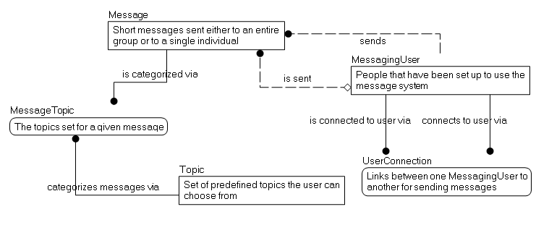
Conceptual Model
Tables, with descriptions and relationships
I often start with a non-data modeling tool (Paper, Visio, OneNote)
Test against the requirements

Slide 20
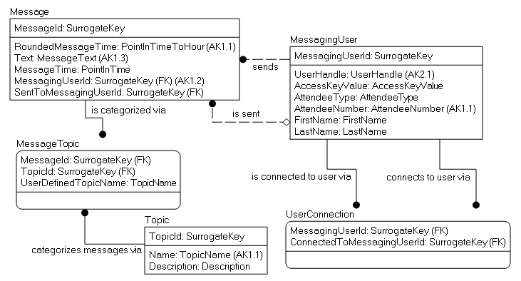
Logical Model
Name: Message
Description: Short messages sent either to an entire group, or to a single individual
Predicates: A message with the same text may only be sent once per hour by the same sender
The “ideal” version of the design
Implementation non-specific

Slide 21
Logical Model Basics - Domains
Name: MessageText
Description: Used to present messages to users
Type of Data: unformatted values, less than or equal to 200 characters
Predicates: Must not be empty or Null, Must not include hate speech, bad language, etc.
Name: PointInTimeToHour
Description: Used to capture the hour of a day when something occurred, probably to limit an action to one an hour
Type of Data: point in time, rounded to nearest hour
Predicates:
Name: SurrogateKey
Description: Used as a stand-in for the natural key
Type of Data: Any
Predicates: The data should be of some format that is small, yet still sufficiently capable of being unique
Domains instead of Data types
  Domains should define the domain of values that can be used
  Data types will specify part of how the domain is implemented
  Check constraints, triggers etc may also be needed to do the implementation

Slide 22
Logical Model Basics - Relationships
Example: If you want to cascade operations on two relationships, this cannot be built as two cascading foreign key constraints
Document all relationship requirements, no matter how you will need to implement them

Slide 23
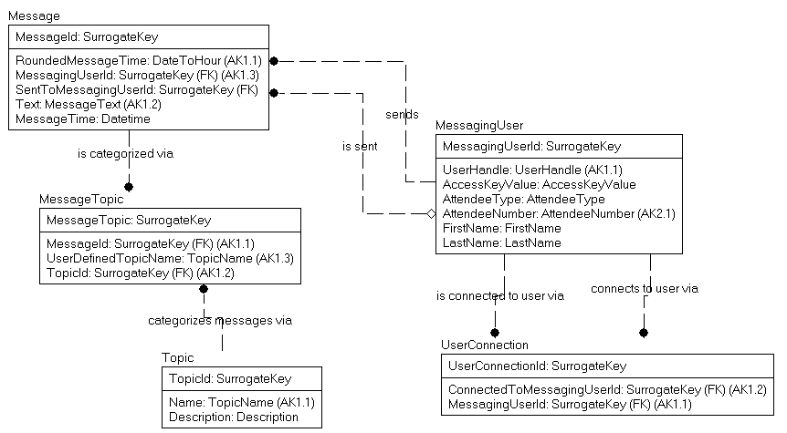
Surrogate Keys on all Tables?
This has a few effects, positive and negative
  Positive: it is very similar to what UI tools often expect
  Negative: Uniqueness and lineage are more difficult to see

Slide 24
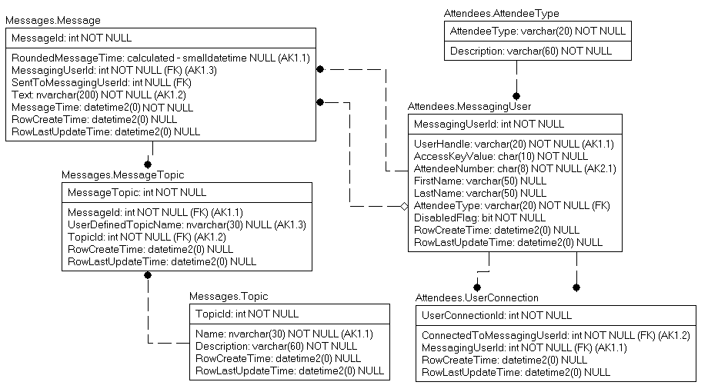
Physical Model
Domain table, added to implement a domain
“Physical” columns added, like RowCreateTime, RowLastUpdateTime
Schemas implemented to segregate tables into “families” for usage/security purposes
Some domains become tables
Best data types chosen

Slide 25
Document
Every table and column should have a succinct description
Then expand complex situations with documents, examples, etc, with the knowledge that will likely not be maintained…
Try to avoid too many examples, as data can change
Ideally, the documentation will be accessible by programmers and end users alike

Slide 26
Are we done yet?
Perhaps
  At this point, it is important to check your model against a standard
  For a relational database, the standards are the Normal Forms

Slide 27
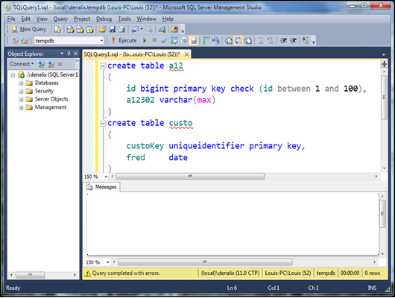
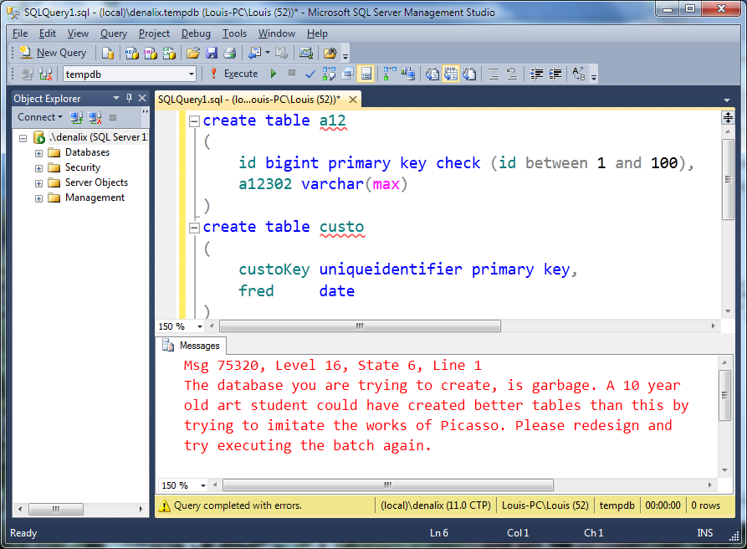
New SQL Server ‘16 Design Assistance Warning Message
Unfortunately this is SQL Server 3016… Until then, we have to do this work on our own.

Slide 28
Normal Forms/Normalization
A process to shape and constrain your design to work with a relational engine
Specified as a series of forms that signify compliance
A definitely non-linear process.
  Used as a set of standards to think of compare to along the way
  After practice, normalization is mostly done instinctively
Written down common sense!

Slide 29
Atomicity
At the lowest level possible without losing the original characteristics
  Similar to context of physics as we know it in the 21st century
  Break down H²0 into Hydrogen and Oxygen, no big deal
  Break down Hydrogen it becomes a different sort of matter and you are going to need a new laboratory

Slide 30
Normal Forms Overview - 1NF
Basic shaping of data for the engine
Data broken down to it’s lowest form
  Column Values are atomic
  No duplicate rows
  All rows must represent the same number of values (Sometimes referenced as “no repeating groups”)
Notes:
SQL works the way SQL works.
<click>
First normal form basically sets up that
Rows are unique
Columns contain just one value (I like to think of this as one value at the lowest form that I will use in SQL. So if I ever need to display phone numbers for a give area code, then I have an area code attribute no matter what)
No columns like Value1, Value2, Value3, where Value1 might be filled in, but not value2 and/or 3. Bloody awful this is. (I have a term coined for this situation in a minute)
<click>
This is the most important normal form, and ANY table in SQL should follow it (XML is an exception, in a way…might make some reference to XML here and how I feel about it)

Slide 31
Your database may not be in 1NF if..
You have string data that contains separator-type characters. Example, patterns using commas, pipes, tildes, etc (even spaces can qualify)
Bitmasks (ew!)
Attribute names with numbers at the end
  Payment1, Payment2, …
Tables with no or poorly defined keys
  CustomerId int identity PRIMARY KEY

Slide 32
First Normal Form Example 1
Requirement: Table of school mascots
To truly be in the spirit of 1NF, some manner of uniqueness constraint needs to be on a column that has meaning
It is a good idea to unit test your structures by putting in data that looks really wrong and see if it stops you, warns you, or something!
~~~~~~~~~~~ ~~~~~~~~~~~
MascotId Name
=========== -----------
1 Smokey
112 Smokey
4567 Smokey
979796 Smokey
Color
-----------
Black/Brown
Black/White
Smoky
Brown
School
-----------
UT
Central High
Less Central High
Southwest Middle

Slide 33
Uniqueness isn’t always naturally attainable
Design for all possible cases, even if you will not be able to implement solely in SQL Server
Some common uniqueness requirements
  Bulk Uniqueness – Inventory of Canned Goods, Parts, etc.
    One row per type of object
  Selective Uniqueness – Unique when filled in: Driver’s License Number, SSN/Work Number, Union Card Number
    Use a unique filtered index (2008+), indexed view (2000- 2005) or triggers (earlier) to implement
  Likely Uniqueness – Data condition where a human should make the decision about uniqueness: Employee names; Customer Information, etc.
Bottom Line: Design all uniqueness situations, enforce as much as possible (and reasonable).

Slide 34
First Normal Form Example 2
Requirement: Store information about books
What is wrong with this table?
  Lots of books have > 1 Author.
What are common way users would “solve” the problem?
  Any way they think of!
What’s a common programmer way to fix this?
BookISBN BookTitle BookPublisher Author
=========== ------------- --------------- -----------
111111111 Normalization Apress Louis
222222222 T-SQL Apress Michael
333333333 Indexing Microsoft Kim
444444444 DB Design Apress Jessica
, Louis
and Louis
& Louis
444444444-1 DB Design Apress Louis

Slide 35
First Normal Form Example 2
Add a repeating group?
What is so wrong?
What is the right way to model this?
BookISBN BookTitle BookPublisher …
=========== ------------- ---------------
111111111 Normalization Apress …
222222222 T-SQL Apress …
333333333 Indexing Microsoft …
444444444 Design Apress …
Author1 Author2 Author3
----------- ----------- -----------
Louis
Michael
Kim
Jessica Louis

Slide 36
First Normal Form Example 2.1
Email1 Email2 Email3
--------- --------- -----------
But inevitably, requirements change, and the structures are inadequate… and unchangeable… So you do something like this (and yes, I had to do this recent enough it still makes me a bit ill:
Email1Status Email1Type Email1PrivateFlag
------------ ------------ -------------------
Email2Status Email2Type Email2PrivateFlag
------------ ------------ -------------------
Email3Status Email3Type Email3PrivateFlag
------------ ------------ -------------------

Slide 37
First Normal Form Example 2
Two tables!
And it gives you easy expansion
BookISBN BookTitle BookPublisher
=========== ------------- ---------------
111111111 Normalization Apress
222222222 T-SQL Apress
333333333 Indexing Microsoft
444444444 DMV Book Simple Talk
BookISBN Author
=========== =============
111111111 Louis
222222222 Michael
333333333 Kim
444444444 Jessica
ContributionType
----------------
Principal Author
Principal Author
Principal Author
Contributor
Principal Author
444444444 Louis

Slide 38
First Normal Form Example 3
Requirement: Store users and their names
How would you search for someone with a last name of Nielsen? David? Davidson?
What if the name were more realistic with Suffix, Prefix, Middle names?
UserId UserName PersonName
=========== ~~~~~~~~~~~~~~ ---------------
1 Drsql Louis Davidson
2 Kekline Kevin Kline
3 Datachix2 Audrey Hammonds
4 PaulNielsen Paul Nielsen

Slide 39
First Normal Form Example 3
Break the person’s name into individual parts
This optimizes the most common search operations
It isn’t a “sin” to do partial searches on occasion, just don’t make it habitual:
  I know the last name ended in “son” or “sen”
If you also need the full name, let the engine manage this using a calculated column:
  PersonFullName AS CONCAT(PersonFirstName + ' ', PersonLastName)
UserId UserName PersonFirstName PersonLastName
=========== ~~~~~~~~~~~~~~ --------------- --------------
1 Drsql Louis Davidson
2 Kekline Kevin Kline
3 Datachix2 Audrey Hammonds
4 PaulNielsen Paul Nielsen

Slide 40
Normal Forms Overview – 2NF, 3NF and Boyce-Codd (BCNF) Normal Forms
Eliminate incorrect data dependencies in your tables
  All attributes are either a key, or fully dependent on a key (the whole key, and nothing but the key)
  Violations usually manifest themselves as multiple column, row-wise repeating groups
In other words…
  All keys for a table are identified
  All columns describe that “thing” that the table is modeling
Notes:
Think of it this way. A key represents the entity that is being model. An attribute describes the entity being modeled. AND NOTHING ELSE…
Sounds simple…AND IT IS…. Just requires thinking…

Slide 41
Intrarow Dependency
If you can determine the value of one attribute X given a different attribute Y, then Y is functionally dependent on X. X is considered the determinant.
Example:
Assuming this is the entire known universe. X is unique key:
  Y and Z are functionally dependent on X
  But, is Z is functionally dependent on Y (or vice versa)?
X | Y | Z
1 | 1 | 2
2 | 2 | 4
3 | 2 | 4

Slide 42
Your database may not be BCNF if..
There are multiple columns with the same prefix
Multiple tables have the exact same complex columns
  Example: Three tables have MessageSentDate, MessageText columns
There are repeating groups of data
  Particularly if > 1 column shows the repeats
There are triggers with modification statements
  Some trigger use to trigger workflow can make sense, but too often it is a matter or maintaining summary/status data

Slide 43
Boyce Codd NF Example 1
Requirement: Defines the types of car(s) that a driver likes
Check the attributes against the meaning of the table
  Height and EyeColor define the attributes of the driver alone
  MaxWeight? The weight of vehicle for that style it is acceptable for the style of car? Or the driver? Naming is important!
    Defined as: Vehicle weight for car style
Driver Car Style Height EyeColor MaxWeight
======== ================ ------- --------- ----------
Louis Station Wagon 6’0” Blue 2900
Louis Hatchback 6’0” Blue 2500
Ted Coupe 5’8” Brown 2200

Slide 44
Boyce Codd NF Example 1
Solution: 3 independent tables, 1 for driver, 1 for driver’s car style preference, 1 for driver and car style
Driver Car Style
======== ================
Louis Station Wagon
Louis Hatchback
Ted Coupe
Driver Height EyeColor
======== ------- ---------
Louis 6’0” Blue
Ted 5’8” Brown
Car Style MaxWeight
================ ----------
Station Wagon 2900
Hatchback 2500
Coupe 2200

Slide 45
Boyce Codd NF Example 2
Requirement: Driver registration for rental car company
Column Dependencies
  Height and EyeColor, check
  VehicleOwned, check
  WheelCount, <buzz>, driver’s do not have wheelcounts
Driver VehicleOwned Height EyeColor WheelCount
======== ---------------- ------- --------- ----------
Louis Hatchback 6’0” Blue 4
Ted Coupe 5’8” Brown 4
Rob Tractor trailer 6’8” NULL 18

Slide 46
Boyce Codd NF Example 2
Two tables, one for driver, one for type of vehicles and their characteristics
Driver VehicleOwned (FK) Height EyeColor
======== ------------------- ------- ---------
Louis Hatchback 6’0” Blue
Ted Coupe 5’8” Brown
Rob Tractor trailer 6’8” NULL
VehicleOwned WheelCount
================ -----------
Hatchback 4
Coupe 4
Tractor trailer 18

Slide 47
Composite Keys - Natural PK
create table driversLicense
(
driversLicenseStateCode char(2) not null,
driversLicenceNumber varchar(40) not null,
classCode char(2) not null,
primary key (driversLicenseStateCode, driversLicenseNumber)
)
create table employee
(
employeeNumber char(10) not null primary key
driversLicenseStateCode char(2) null,
driversLicenceNumber varchar(40) null,
firstName varchar(30) not null,
middleName varchar(30) null,
lastName varchar(30) not null,
unique (driversLicenseStateCode, driversLicenseNumber)
foreign key (driversLicenseStateCode, driversLicenseNumber)
references driversLicense(driversLicenseStateCode, driversLicenseNumber)
)

Slide 48
Composite Keys – The Surrogate Effect
This is a mathematically equivalent representation
create table driversLicense
(
driversLicenseId int primary key –might be identity or even GUID
driversLicenseStateCode char(2),
driversLicenceNumber varchar(40),
classCode char(2),
unique (driversLicenseStateCode, driversLicenseNumber)
)
create table employee
(
employeeId int identity primary key, –might be identity or even GUID
employeeNumber char(10) not null unique,
driversLicenseId int null unique
references driversLicense(driversLicenseId)
firstName varchar(30) not null,
middleName varchar(30) null,
lastName varchar(30) not null
)

Slide 49
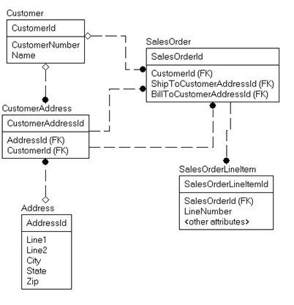
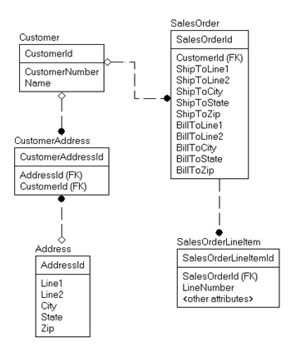
Quiz – Which Model is Correct?
Or
A
B

Slide 50
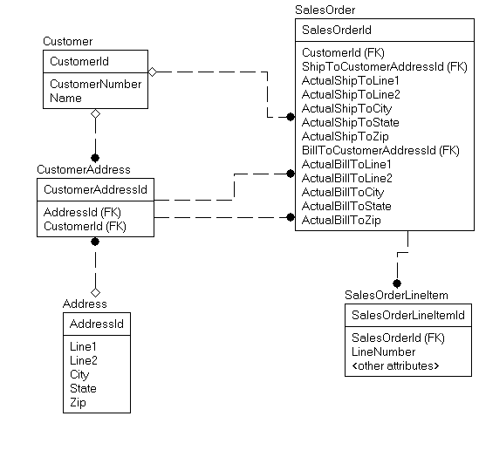
Quiz – Answer “It depends…perhaps both”

Slide 51
Fourth and Fifth Normal Forms
Deals with the relationships within key attributes
In practical terms, it deals when a single row actually has multiple meanings that are not immediately obvious
What makes it challenging that the same table may or may not be in Fourth or Fifth Normal Form depending on subtle differences in requirements
If a table is properly in Third Normal Form, and EFFECTIVELY has no three part composite keys, it is already in Fifth Normal Form

Slide 52
Fourth Normal Form
The key of every table should represent no more than one independent multi-valued relationship
In other words, the combination of key attributes should represent one thing only

Slide 53
Is Fourth Normal Form relevant?
A 1992 paper by Margaret S. Wu notes that the teaching of database normalization typically stops short of 4NF, perhaps because of a belief that tables violating 4NF (but meeting all lower normal forms) are rarely encountered in business applications. This belief may not be accurate, however. Wu reports that in a study of forty organizational databases, over 20% contained one or more tables that violated 4NF while meeting all lower normal forms.
http://en.wikipedia.org/wiki/Fourth_normal_form

Slide 54
Fourth Normal Form Example
Requirement: define the classes offered with teacher and book
Dependencies
  Class determines Trainer (Based on qualification)
  Class determines Book (Based on applicability)
  Trainer does not determine Book (or vice versa)
If trainer and book are related (like if teachers had their own specific text,) then this table is in 4NF
Trainer Class Book
========== ============== ================================
Louis Normalization DB Design & Implementation
Chuck Normalization DB Design & Implementation
Fred Implementation DB Design & Implementation
Fred Golf Topics for the Non-Technical

Slide 55
Fourth Normal Form Example
Trainer Class Book
========== ============== ================================
Louis Normalization DB Design & Implementation
Chuck Normalization DB Design & Implementation
Fred Implementation DB Design & Implementation
Fred Golf Topics for the Non-Technical
Question: What classes do we have available and what books do they use?
SELECT DISTINCT Class, Book
FROM TrainerClassBook
Class Book
=============== ==========================
Normalization DB Design & Implementation
Implementation DB Design & Implementation
Golf Topics for the Non-Technical
Doing a very slow operation, sorting your data, unnecessarily… please wait

Slide 56
Fourth Normal Form Example
Break Trainer and Book into independent relationship tables to Class
Class Trainer
=============== =================
Normalization Louis
Normalization Chuck
Implementation Fred
Golf Fred
Class Book
=============== ==========================
Normalization DB Design & Implementation
Implementation DB Design & Implementation
Golf Topics for the Non-Technical

Slide 57
Fifth Normal Form
A general rule that breaks out any data redundancy that has not specifically been called out by additional rules
Like Fourth Normal Form, deals with the relationship between key attributes
Basically, if you can break a table with three (or more) independent keys into three individual tables and be guaranteed to get the original table by joining them together, the table is not in Fifth Normal Form
An esoteric rule that is only occasionally violated (but still interesting!)

Slide 58
Fifth Normal Form Example
Requirement: Store types of cars driver willing to rent
Table is in 5NF if this represents:
  Louis is strictly willing to drive any Ford Station Wagon or Hyundai Hatchback
  Ted is willing to drive any Coupe from Chevrolet
Because:
  Driver determines Car Style
  Driver determines Car Brand
  Car Brand determines Car Style
  Driver determines Car Style and Car Brand
Driver Car Style Car Brand
=================== ======================== ===============
Louis Station Wagon Ford
Louis Hatchback Hyundai
Ted Coupe Chevrolet

Slide 59
Fifth Normal Form Example
Requirement: Store types of cars driver willing to rent
Table is not in 5NF if this represents:
  Louis is willing to drive any Station Wagon or Hatchback from Ford or Hyundai
  Ted is willing to drive any Coupe from Chevrolet
Still 4th Because:
  Driver determines Car Style
  Driver determines Car Brand
  Car Brand determines Car Style
Driver Car Style Car Brand
=================== ======================== ===============
Louis Station Wagon Ford
Louis Hatchback Hyundai
Ted Coupe Chevrolet

Slide 60
Fifth Normal Form Example
Solution: Three independent tables
Driver Car Style
=================== =======================
Louis Station Wagon
Louis Hatchback
Ted Coupe
Driver Car Brand
=================== =======================
Louis Ford
Louis Hyundai
Ted Chevrolet
Car Style Car Brand
============================= =======================
Station Wagon Ford
Hatchback Hyundai
Coupe Chevrolet

Slide 61
Fifth Normal Form Example
Driver Car Style Car Brand
=================== ======================= ===============
Louis Station Wagon Ford
Louis Hatchback Hyundai
Ted Coupe Chevrolet
Alternative: Table is in 5NF if this represents:
  Louis is willing to drive Ford Station Wagons and Hyundai Hatchbacks
  Ted is willing to drive a Chevrolet Coupe
  Ford only makes (or we only stock) a Station Wagon, Hundai only makes a hatchback and Chevrolet only makes a coupe
Because: Driver determines Car Style + Car Brand
In a well designed system, with these requirements…
  The intersection of Style and Brand would have formed it’s own table
  Car Style/Car Brand would have been recognized as an independent object with a specific key (often a surrogate).

Slide 62
Book, editor, author
Requirement: Represent books with their authors and editors
Table is in not in 4NF if this represents:
  Book “Design” has authors Louis and Jeff and Editor Tony
  Book “Golf” has authors Louis and Fred and Editors Steve and Tony
Table is in 5NF if this represents
  For book “Design”, Editor Tony edits Louis’ work and Leroy edits Jeff’s work
  For book “Golf”, Editor Steve edits Louis’ work, and Tony edits Fred’s work.
Book Author Editor
=================== =================== ===============
Design Louis Tony
Design Jeff Leroy
Golf Louis Steve
Golf Fred Tony

Slide 63
Normal Review
The normal forms should govern the design for the models you create
First Normal Form is for the engine
  Even data warehouses are largely in First Normal Form!
BCNF, Fourth, and Fifth are for data consistency
In the end you get a programming surface that is resilient to change and works like SQL Server expects
This isn’t hard stuff!

Slide 64
Can you over-normalize?
Short answer: sort of
Long answer: no
  Match the design to the user’s needs
  Breaking objects down beyond user needs is not productive
  Lots of joins are not always that costly
  Over-normalization is usually over-engineering past what the user needs

Slide 65
Normalization Final Scan
(The Normal way to Normalize)
Columns - One column, one value
Table/row uniqueness – Tables have independent meaning, rows are distinct from one another.
Proper relationships between columns – Columns either are a key or describe something about the row identified by the key.
Scrutinize dependencies - Make sure relationships between three values or tables are correct. Reduce all relationships to binary relationships if possible.

Slide 66
Normalization is done when..
Data can be used programmatically without parsing
Users have exactly the right number of places to store the data they need
Users stop changing their needs
Pretty much when a system is completely retired
Notes:
[twitter]Usually you are finished normalizing a system when it is replaced… User needs change the requirement constantly @rmtechtrifecta [/twitter]

Slide 67
Denormalization
Adjusting a design that has been normalized in a manner that has caused some level of problem
Usually this is sold as having to do with performance or usability
Common saying
    Normalize ‘til it hurts, Denormalize ‘til it works
    Normalize ‘til it works.
      In reality, there is very little reason to denormalize when Normalization has been done based on requirements and user need.
  There are common exceptions…

Slide 68
Typically acceptable denormalization
When read/write ratio approaches infinity
Examples
  Balances/Inventory as of a certain date (summing activity after that date for totals)
    Allows you to query a LOT LESS data
  Calendar table
    November 15, 2006 with always be a Wednesday
  Table of integers
    Prime Numbers
    Odd Numbers

Slide 69
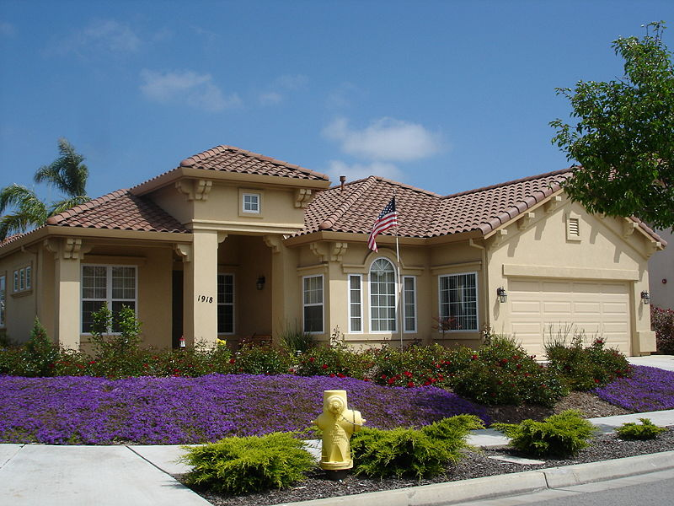
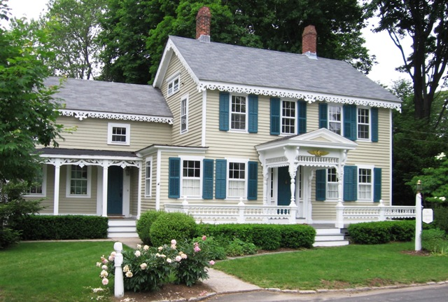
Final Exam: Data Model For a House
A company needs a database to model houses on a block
Unless I tell you what the company does, you will not get the answer right… Perspective is everything!

Slide 70
“Daydream” Practice
A good way to get better is to pick out scenarios in real life and mentally model them
Such as:
  Grocery list management
  DMV
  Theme park operations
Build models in your spare time to reinforce your daydreams and your modeling skills
Warning: telling non-nerdy people you do this will open you up to teasing.

Slide 71
So you have a design…build!
I usually build to a SQL Server that contains model databases
Strongly consider using SQL Server to implement checks, domains, constraints on what can be entered
Minimally, make certain that the data is protected at a level lower than a user can get access
Ideally:
  You should trust that your data is valid to the immutable business rules at all times
  The only data cleansing you should ever do is to look for users doing dumb stuff

Slide 72
Test…test…test
Start building unit tests in during conceptual modeling that you can run to make sure that your design works
Remember the requirements? Develop the test plan directly from them
Throw tons of bad data at the design, especially places where you thought data should have been designed better
Try to get an error for every constraint implemented
Try to get an error for every constraint NOT implemented

Slide 73

Questions? Contact info..
Louis Davidson - louis@drsql.org
Website – http://drsql.org ← Get slides here
Twitter – http://twitter.com/drsql
SQL Blog http://sqlblog.com/blogs/louis_davidson
Simple Talk Blog – What Counts for a DBA
http://www.simple-talk.com/community/blogs/drsql/default.aspx
Notes:
[twitter] Slides will be on drsql.org in the presentations area for this and the keynote as soon as I can get them out there. @rmtechtrifecta [/twitter]

Slide 74
Thank you!

